Slide 1
Mini Project Seminar On Sports Academy Training Scheduler POC

Slide 2
Student Reg : KUB23CSE114
Name of student : Rakshitha
Name of Institution : Kishkinda University
Department Name : Computer Science
Year of Study : 2024
Submission date : 28-09-2024

Slide 3
Description :
Introduction
Objectives
Methodology
Results/Findings
Conclusions
References

Slide 4

Welcome to our presentation of the Sports Academy Training Scheduler, a comprehensive software solution designed to streamline the training process for athletes of all ages and levels
Sports Academy Training Scheduler
Introduction:

Slide 5
Objective: Simplifying sports training management processes
Addressing the need for efficient scheduling and attendance monitoring in sports academies
Enhancing overall training program organization and effectiveness

Slide 6
The primary objective is to create a user-friendly interface for scheduling training sessions. We aim to implement a robust system for managing training programs effectively. This POC will serve as a foundation for future enhancements and integrations
Objective:

Slide 7
Develop an intuitive system for managing training sessions and tracking attendance
Streamline administrative tasks to optimize sports academy operations
Improve communication and coordination among coaches, staff, and athletes

Slide 8
Implement advanced data analytics capabilities to analyze training performance, athlete progress, and session effectiveness.
Integrate reporting tools to generate insights for coaches, administrators, and athletes to optimize training programs.
Enhance the system's scalability to support a growing number of athletes, coaches, and training programs.
Extend support to multiple sports disciplines within the academy to cater to diverse training needs and requirements.

Slide 9
Methodology :
Leveraged Python for its versatility and ease of use
Detailed design of classes to handle different aspects of the system
Implementation of key features like creating, updating, and deleting training sessions
Rigorous testing using the unittest framework to ensure system reliability

Slide 10
Utilized Python programming language due to its versatility and extensive libraries for web development.
Employed Flask, a lightweight web framework, for building the backend of the application. -
Leveraged SQLite database for data storage due to its simplicity and compatibility with Python.

Slide 11
Results / Finding:
Successful integration of core functionalities for program scheduling and attendance monitoring
Enhanced data management capabilities for better decision-making
Positive impact on streamlining training operations and improving overall efficiency

Slide 12
The system has demonstrated the ability to efficiently schedule training programs based on coach availability, facility resources, and athlete preferences.
Automated scheduling algorithms have optimized session allocation and minimized conflicts.
Attendance monitoring features have enabled coaches and administrators to track athlete participation in training sessions accurately.
Real-time attendance updates have improved accountability and performance evaluation.

Slide 13
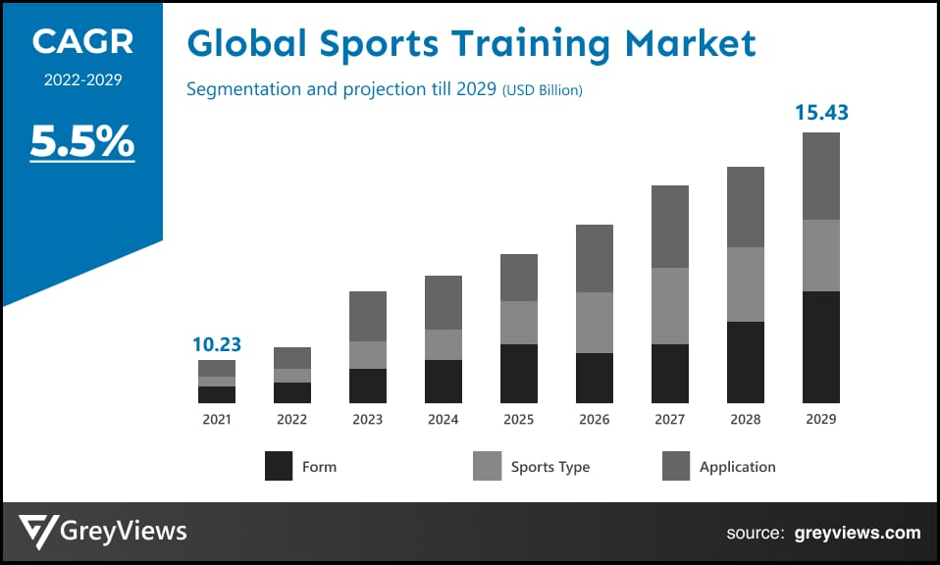

Slide 14
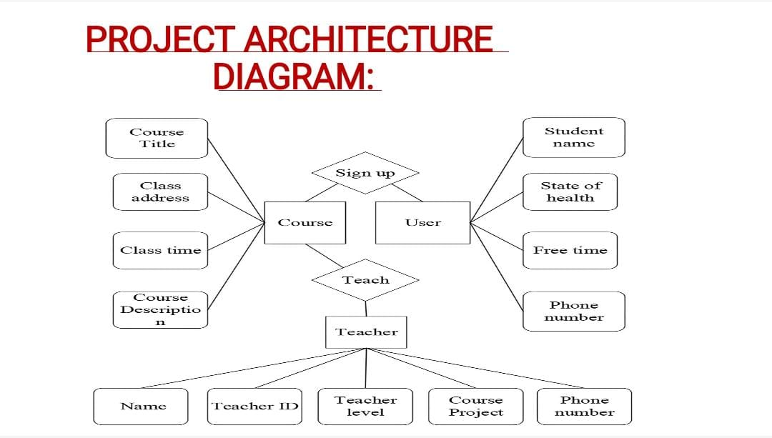

Slide 15
class TrainingSession:
def __init__(self, session_id: str, title: str, coach: str, duration: float, level: str):
self.session_id = session_id
self.title = title
self.coach = coach
self.duration = duration
self.level = level
def __str__(self) -> str:
return f"Session ID: {self.session_id}, Title: {self.title}, Coach: {self.coach}, Duration: {self.duration}h, Level: {self.level}"
class TrainingProgram:
def __init__(self, program_id: str, description: str):
self.program_id = program_id
self.description = description
self.sessions = []
def add_session(self, session: TrainingSession) -> None:
self.sessions.append(session)
def remove_session(self, session_id: str) -> None:
self.sessions = [s for s in self.sessions if s.session_id != session_id]
def get_sessions(self) -> list:
return self.sessions
def __str__(self) -> str:
return f"Program ID: {self.program_id}, Description: {self.description}, Sessions: {len(self.sessions)}"
class ScheduleManager:
def __init__(self):
self.programs = {}

Slide 16
self.programs[program.program_id] = program
def delete_program(self, program_id: str) -> None:
if program_id in self.programs:
del self.programs[program_id]
def get_program(self, program_id: str) -> TrainingProgram:
return self.programs.get(program_id, None)
class AttendanceManager:
def __init__(self):
self.attendance = {}
def record_attendance(self, session_id: str, attendees: list) -> None:
self.attendance[session_id] = attendees
def get_attendance(self, session_id: str) -> list:
return self.attendance.get(session_id, [])
def main():
schedule_manager = ScheduleManager()
attendance_manager = AttendanceManager()
while True:
print("\nMenu:")
print("1. Add Training Program")
print("2. Add Session to Program")
print("3. View Sessions in Program")
print("4. Remove Session from Program")
print("5. Record Attendance")
print("6. View Attendance")
print("7. Exit")
choice = input("Choose an option: ")

Slide 17
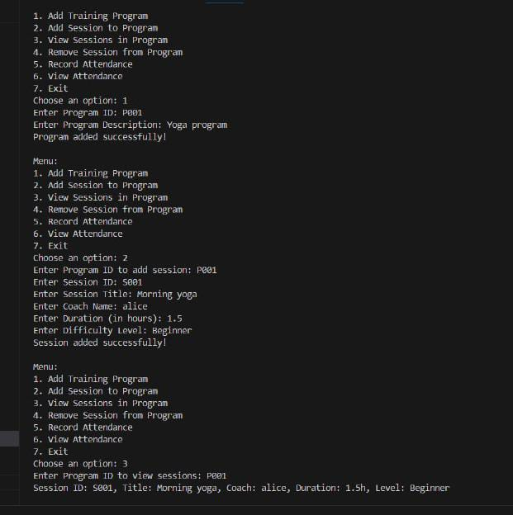

Slide 18
A well-structured training schedule is essential for maximizing athlete performance and development. Regular assessments and adjustments to the schedule can enhance training efficiency and address individual needs. Ultimately, a balanced schedule fosters not only physical growth but also mental resilience among athletes.
Conclusion:

Slide 19
The Sports Academy Training Scheduler system has significantly enhanced operational efficiency by streamlining training session management and attendance tracking processes.
Coaches, staff, and athletes can now focus more on training and performance improvement rather than administrative tasks.
The system has facilitated better communication and coordination among stakeholders by providing a centralized platform for scheduling and attendance monitoring.
Real-time updates and notifications have improved responsiveness and collaboration within the sports academy.

Slide 20
There is great potential for further development and enhancement of the system, such as integrating advanced analytics for performance tracking, incorporating machine learning algorithms for personalized training recommendations, and expanding to support multiple sports disciplines.
Finally, it is one of the best Method where we can solve a lot of problems in upcoming days.

Slide 21
Refernce:
Acknowledgment of resources, tools, and frameworks utilized in the project
Providing a foundation for continued learning and exploration in sports management systems
Tools:
Git: Version control system for tracking changes in codebase -
Unittest: Python unit testing framework for testing individual components

Slide 22


Slide 23


